Slide 1





Java Reloaded
JDK 7

Slide 2

Objective

Slide 3

JDK Release History
Version | Release Date
J2SE 1.4.1 | 2002-09-16
J2SE 1.4.2 | 2003-06-26
J2SE 5.0 | 2004-09-29
J2SE 6 | 2006-12-11
Future Releases
J2SE 7 | 2011-07-28
J2SE 8 | Expected in late 2012

Slide 4

How to Try JDK 7 Features?
1.
◎
2.
◎
3.
4.
5.
6.
7. On Project Properties' Sources section Select JDK 7 as Source/Binary Format

Slide 5




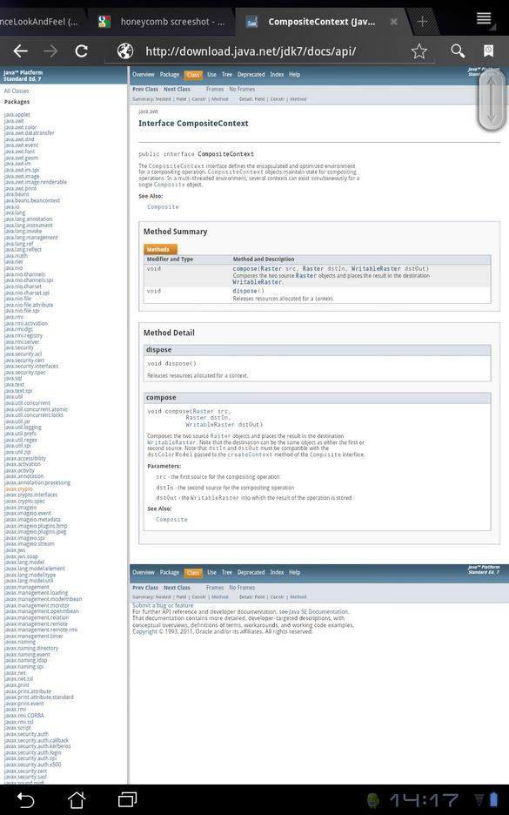
New Javadoc Format

Slide 6

Project Coin
◎
◎
◎
◎
◎
Try with resource
Simplified vararg methods invocation

Slide 7

String in Switch Statement
◎
◎
◎
Console console = System.console(); String day= console.readLine(); switch (day) {
case "monday" : console.writer().write("1");break; case "tuesday" : console.writer().write("2");break; case "wednesday" : console.writer().write("3");break; case "thursday" : console.writer().write("4");break; case "friday" : console.writer().write("5");break; case "saturday" : console.writer().write("6");break; case "sunday" : console.writer().write("7");break; default:console.writer().write("?");
}
console.flush();

Slide 8

Binary Literals
◎
◎ int mask = 0b00000000000000000000000011111111;
int mask = Integer.parseInt;͞ϬϬϬϬϬϬϬϬϬϬϬϬϬϬϬϬϬϬϬϬϬϬϬϬϭϭϭϭϭϭϭϭ͟, ϮͿ;
int mask = 255;

Slide 9

Underscores in Numbers
◎
◎
◎

Slide 10

Diamond Operator
◎
◎
<>

Slide 11




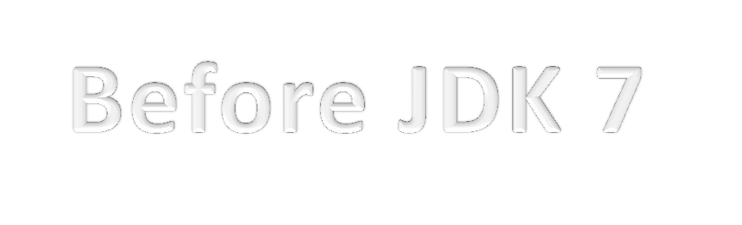




Multi Catch and Final Rethrow
try {
InputStream inStream = readStream(settingFile); Setting setting = parseFile(inStream);
} catch (IOException ex) {
log.warn(“Can not access file”, settingFile);
} catch (FileNotFoundException ex) { log.warn(“Can not access file”, settingFile);
} catch (ParseException ex) {
log.warn(“{} has incorrect format:{}”, settingFile, ex.getMessage());
}
try {
InputStream inStream = readStream(settingFile); Setting setting = parseFile(inStream);
} catch (IOException | FileNotFoundException ex) {
log.warn(“Can not access file”, settingFile);
} catch (ParseException ex) {
log.warn(“{} has incorrect format:{}”, settingFile, ex.getMessage());
}

Slide 12





Multi Catch and Final Re-throw Cont.
public Setting readSettings(Strin settingFile) throws ParseException, IOException,
FileNotFoundException {
try {
InputStream inStream = readStream(settingFile); Setting setting = parseFile(inStream);
} catch (Throwable ex) {
log.warn(“Can not read settings”, settingFile); throw ex;
}
……………..
}

Slide 13




Try With Resource
private static String readConfiguration(String file) { BufferedReader reader = null;
try {
reader = new BufferedReader(new FileReader(file)); String line = null;
StringBuilder content = new StringBuilder(1000); while ((line = reader.readLine()) != null) {
content.append(line);
}
return content.toString();
} catch (IOException ex){
throw new ConfigurationException("Can not read configuration file:{}", file);
} finally {
if (reader != null) {
try {
reader.close();
} catch (IOException ex) { ex.printStackTrace();
}
}
}
}

Slide 14








Try With Resource Cont’
private static String readConfigurationNew(String file) {
try (BufferedReader reader = new BufferedReader(new FileReader(file));) { String line = null;
StringBuilder content = new StringBuilder(1000); while ((line = reader.readLine()) != null) {
content.append(line);
}
return content.toString();
} catch (IOException ex){
throw new ConfigurationException("Can not read configuration file:{}", file);
}
}

Slide 15



Try With Resource and Autocloseable
◎
◎
◎
◎
AutoCloseable are suppressed in favor of
exceptions throwed from try-catch block
  See JavaDoc of Autocloseable for more detail

Slide 16





Autocloseable and Suppressed Exception
public ABCResource implements AutoCloseable {
@Override
public void close() throws ABCException {
dosomething();
if (errorCondition) {
throw new ABCException("Not supported yet.");
}
}
}
public ClientClass {
public void useABCResource() {
try (ABCResource resource = new ABCResource();) { dosomething();
if (errorCondition) {
throw new ClientException("Not supported yet.");
}
}
}
}

Slide 17


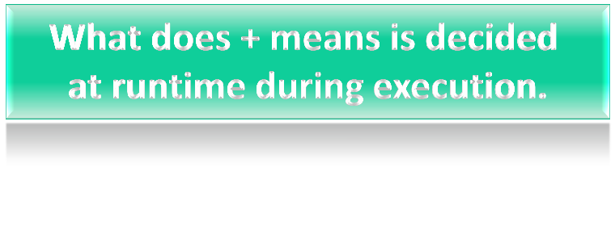
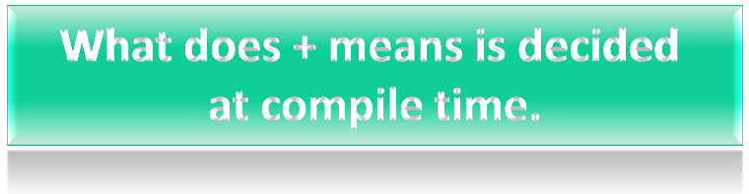
Better Support for Other Languages in JVM
◎
◎
◎
◎
◎
◎
◎
  Java is a strongly typed language
public void printTotal(a, b) { print a + b;
}
public void printTotal(int a, int b) { print a + b;
}

Slide 18





Dynamic Typing was Difficult to Implement on JVM
invokedynamic

Slide 19


Fork/Join Framework
◎
work-stealing
◎
◎
ExecutorService
  ForkJoinTask
RecursiveAction and RecursiveTask are added

Slide 20

General Usage Pattern of Fork/Join
Result compute(Problem problem) { if (problem is small)
directly solve problem else {
split problem into independent parts fork new subtasks to solve each part join all subtasks
compose result from subresults
}
else {
RecursiveTask left = new ComputationTask(array, low, mid); RecursiveTask right = new ComputationTask(array, mid, high); right.fork();
return left.compute() + right.join();
}
main {
RecursiveTask computationTask = new ComputationTask(array, 0, array.length); ForkJoinPool mainPool = new ForkJoinPool();
Long result = mainPool.invoke(computationTask);
}

Slide 21

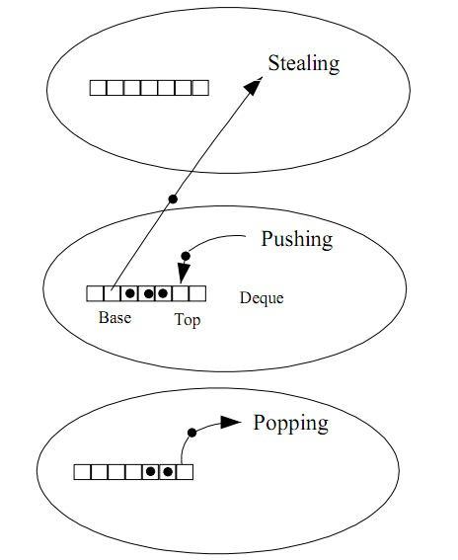
Work Stealing
◎
◎
◎

Slide 22

TransferQueue
transfer(E e)
◎
tryTransfer(E e)
◎
tryTransfer(E e, long timeout, TimeUnit unit)
◎
getWaitingConsumerCount()
◎
hasWaitingConsumer()
  Returns true if there is at least one consumer waiting to receive an element via BlockingQueue.take () or timed poll.

Slide 23

ThreadLocalRandom
◎
◎
◎
ThreadLocalRandom.current().nextInt(min, max);
ThreadLocalRandom.current().nextLong(min, max);
ThreadLocalRandom.current().nextDouble(min, max);

Slide 24

ConcurrentLinkedDeque
◎
◎
◎
throw ConcurrentModificationException
size() method is NOT constant in time
Bulk operations are not guaranteed to perform atomically

Slide 25

Phaser
◎
◎
Allows number of registered parties to change after
Phaser creation
◎
There are blocking and non blocking versions of operations
  Extremely flexible and complex, use Javadoc
when you need to use this class

Slide 26


SCTP Support
Feature
SCTP
TCP
UDP
Connection-oriented
✓
✓
Full duplex
✓
✓
✓
Reliable data transfer
✓
✓
Partial-reliable data transfer
optional
Ordered data delivery
✓
✓
Unordered data delivery
✓
✓
Flow control
✓
✓
Congestion control
✓
✓
ECN capable
✓
✓
Selective ACKs
✓
optional
Preservation of message boundaries
✓
✓
Path MTU discovery
✓
✓
Application PDU fragmentation
✓
✓
Application PDU bundling
✓
✓
Multistreaming
✓
Multihoming
✓
Protection against SYN flooding attacks
✓
n/a
Allows half-closed connections
✓
n/a
Reachability check
✓
✓
Psuedo-header for checksum
(uses vtags)
✓
✓
Time wait state
for vtags
for 4-tuple
n/a
Not all operating systems support SCTP

Slide 27

The Need for Java NIO.2
◎
◎
◎
◎
◎
◎
◎
over network directories)
A change notification facility is not provided
Developers wanted to create their own file system implementations
  For example an in-memory file system

Slide 28


Pluggable FileSystems
◎
◎
◎
◎
java.nio.file.FileSystems.getDefault() is used most of the time
Multiple/Alternate views of same underlying files
  Hides some files for security, read-only view, etc.

Slide 29



java.nio.file.Path and java.nio.file.Files
◎ |  | java.nio.file.Path java.nio.file.Files
 | ◎ | java.io.File.toPath | java.nio.file.Path.toFile
  java.nio.file.Paths
◎
◎
  Once you obtained Path object use java.nio.file.Files
static methods to process
  copy, createLink, createTempFile, delete, exist, getPosixFilePermissions, getAttribute, isHidden, isExecutable, isSymbolicLink, newByteChannel ……

Slide 30

Asynchronous I/O
◎
◎
Future<V> operation(...)
void operation(... A attachment, CompletionHandler<V,? super A> handler)
AsynchronousXXXXChannel
AsynchronousChannel
◎
Path path = Paths.get;͞/hoŵe/deniz/dropbox/Getting Started.pdf"); AsynchronousFileChannel ch = AsynchronousFileChannel.open(path); ByteBuffer buf = ByteBuffer.allocate(1024);
Future<Integer> result = ch.read(buf, 0); //read does not block while (!result.isDone()) {
System.out.println;͞lets do soŵethiŶg else while waitiŶg"Ϳ;
}
System.out.println("Bytes read = " + result.get()); //Future.get will block
ch.close();

Slide 31


Watch Service
◎
◎
WatchKey register(WatchService watcher, WatchEvent.Kind<?>... events)
◎
◎
◎
Path path = Paths.get("C:/Users/Deniz/Dropbox/");
WatchService watcher = path.getFileSystem().newWatchService(); while (true) {
path.register(watcher, StandardWatchEventKinds.ENTRY_CREATE);
WatchKey key = watcher.take(); // block for event
for (WatchEvent event : key.pollEvents()) {
Path pathOfNewFile = (Path) event.context(); // path of new file System.out.println("File is created:" + pathOfNewFile.toString());
}
key.cancel();
}

Slide 32

FileVisitor
Path start = ...
Files.walkFileTree(start, new SimpleFileVisitor<Path>() {
public FileVisitResult visitFile(Path file, BasicFileAttributes attrs) throws IOException {
Files.delete(file);
return FileVisitResult.CONTINUE;
}
public FileVisitResult postVisitDirectory(Path dir, IOException e) throws IOException { if (e == null) {
Files.delete(dir);
return FileVisitResult.CONTINUE;
} else {
// directory iteration failed throw e;
}
}});

Slide 33

FileTypeDetector
Files.walkFileTree(Paths.get("C:/Users/Deniz/Downloads"), new SimpleFileVisitor<Path>() { public FileVisitResult visitFile(Path file, BasicFileAttributes attrs) throws IOException {
String fileType = Files.probeContentType(file); System.out.println(file.toString() + ":" + fileType); return FileVisitResult.CONTINUE;
}
});
Output:
C:\Users\Deniz\Downloads\Wirofon-Client-0.2.10-rc01.exe:application/x-msdownload C:\Users\Deniz\Downloads\Plan B-She Said.mp3:audio/mpeg C:\Users\Deniz\Downloads\ROM or Kernel-Update.pdf:application/pdf

Slide 34

Xrender Pipeline
◎
◎
◎
◎
Xrender applications are native X11 applications
Other GUI libraries are also using Xrender for 2D
effects
  QT4, GTK+, KDE4
  Use -Dsun.java2d.xrender=true to enable it

Slide 35



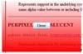
Translucent Windows
◎
◎
◎
setUndecorated(true);
setOpacity (opacityValue); //opacity value is between 0.0 – 1.0
◎
Color colorA = new Color (255, 0, 0, 0); // Transparent red
Color colorB = new Color (255, 0, 0, 255); // Solid red
setBackground(new Color (0, 0, 0, 0)); // activate per-pixel
// translucency.
protected void paintComponent (Graphics g) { Graphics2D g2d = (Graphics2D) g; GradientPaint gp = new GradientPaint (
0.0f, 0.0f, colorA, 0.0f, getHeight (), colorB, true); g2d.setPaint (gp);
g2d.fillRect (0, 0, getWidth (), getHeight ());
}
Transparent and shaped windows

Slide 36

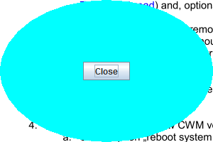
Shaped Windows
◎
◎
Shape
clickable
◎
setUndecorated(true);
setShape(new Ellipse2D.Float (0, 0, getWidth (), getHeight ()));
For code samples see: Exploring JDK 7, Part 2: Translucent and Shaped Windows

Slide 37



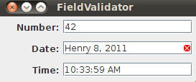
JLayer and LayerUI
◎
◎
LayerUI<JFormattedTextField> layerUI = new ValidationLayerUI();
…...
JFormattedTextField dateField = new JFormattedTextField(dateFormat); JFormattedTextField numberField = new JFormattedTextField(numberFormat);
……
JPanel datePanel = new JPanel();
……
datePanel.add(new JLayer<JFormattedTextField>(dateField, layerUI)); datePanel.add(new JLayer<JFormattedTextField>(numberField , layerUI));
……
class ValidationLayerUI extends LayerUI<JFormattedTextField> { public void paint (Graphics g, JComponent c) {
super.paint (g, c);
JLayer jlayer = (JLayer) c;
JFormattedTextField ftf = (JFormattedTextField)jlayer.getView(); if (!ftf.isEditValid()) {
//paint an error indicator using Graphics
}
}
}
//See http://download.oracle.com/javase/tutorial/uiswing/misc/jlayer.html for details

Slide 38


java.util.Objects
◎
◎
String
◎
NullPointerException
Comparator
Object Object
Object Object
◎
◎
◎
  Perform null checks and Arrays.deepEquals if necessary
  String toString(Object o, String nullDefault)
  Perform null check and return nullDefault if o is null
  There are other similar methods, check javadoc

Slide 39

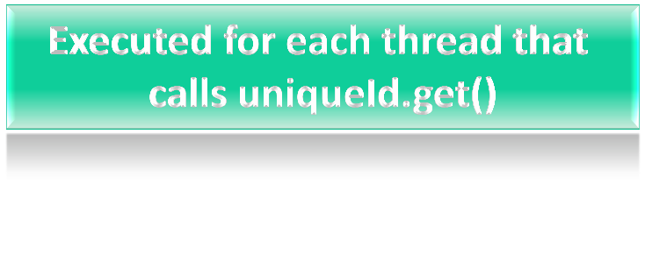
ThreadLocal
◎
import java.util.concurrent.atomic.AtomicInteger; public class UniqueThreadIdGenerator {
private static final AtomicInteger uniqueId = new AtomicInteger(0);
private static final ThreadLocal<Integer> uniqueNum = new ThreadLocal<Integer> () {
@Override
protected Integer initialValue() { return uniqueId.getAndIncrement();
}
};
public static int getCurrentThreadId() {
return uniqueId.get();
}
} // UniqueThreadIdGenerator

Slide 40

Locale Category
◎
◎
◎
◎
◎
◎
◎
It stays as a different locale (not display or format)
But Locale.setDefault(Locale) sets 3 different locales now:display, format and default locales
Default locale depends on OS environment variables or value of
–D flags. Set it to English for your health and change newly provided locales (display/format)

Slide 41

References
Exploring JDK 7, Part 2: Translucent and Shaped Windows
What’s New in NIO.2
JDK 7 Features
The Java NIO.2 File System in JDK 7
Xrender Proposal
Java 2D Enhancements in Java SE 7
How to Decorate Components with the JLayer Class
StackOverflow

